Slide 1


A.O.K Laptop Overhaul System
Course project for: IS 436 Structured Systems Analysis and Design
Presented by:
Nima Roomi, Alex Varghese, Upen Adhikari, Omar Al-Hedari, Ralu Ofoche

Slide 2
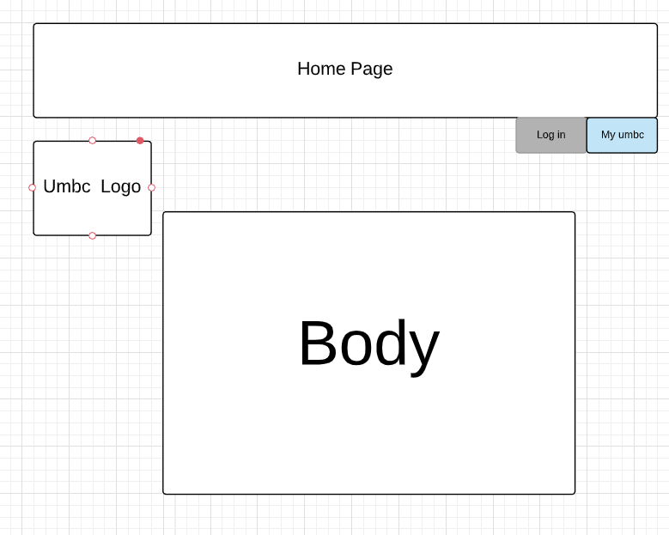
Home Page Prototype

Slide 3
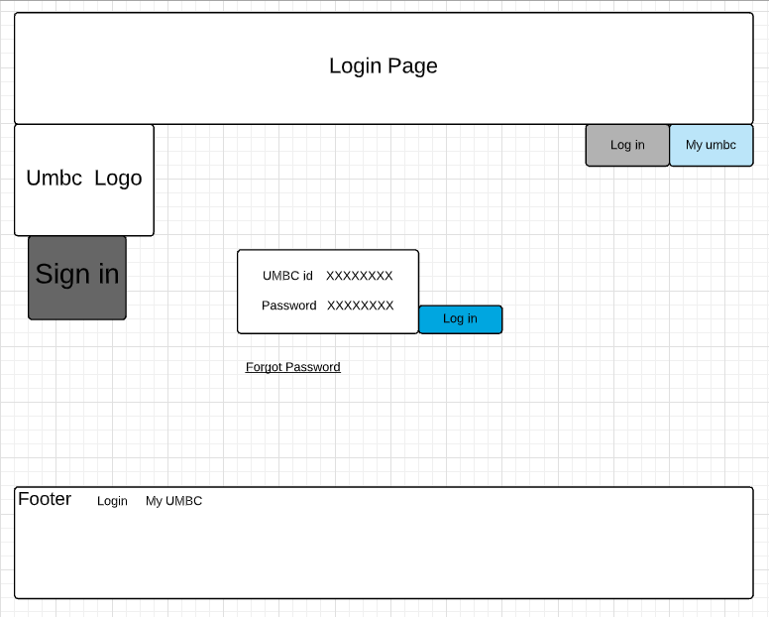
Login Page Prototype

Slide 4
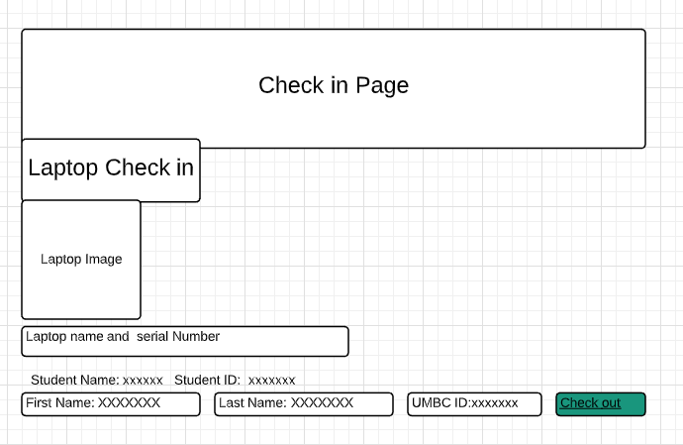
Check In Prototype

Slide 5
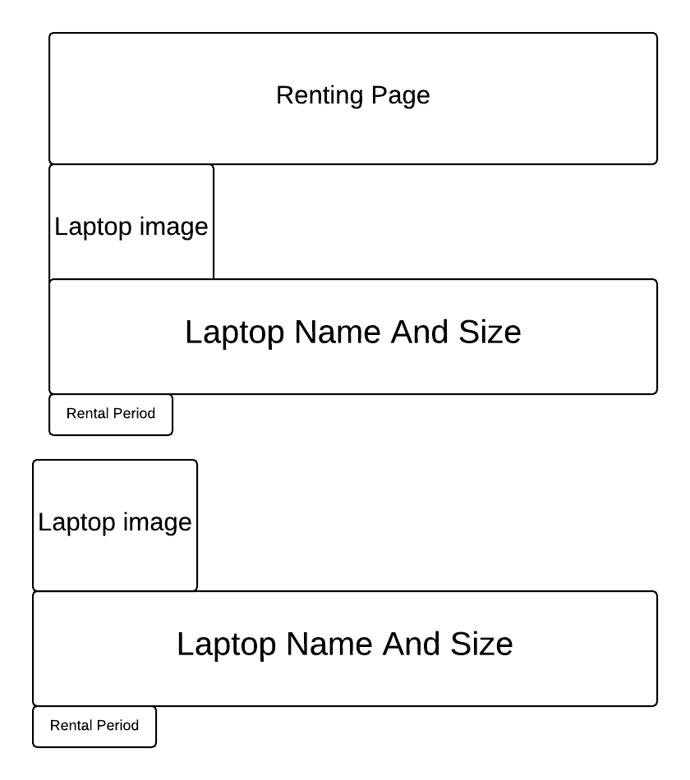
Renting Page Prototype

Slide 6
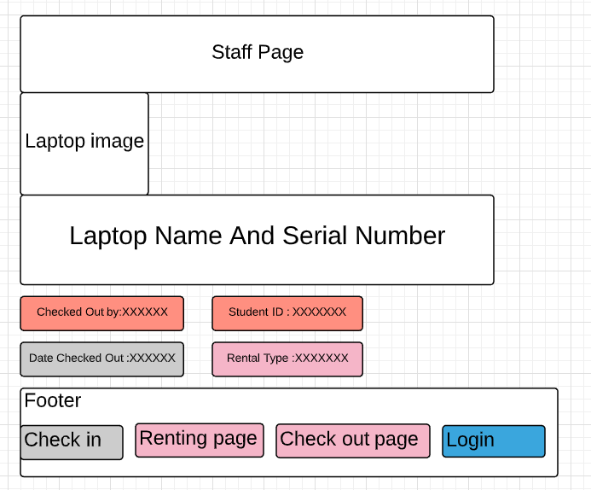
Staff Page Prototype

Slide 7

Sign In Page https://rofoche1.github.io/AOKlibrary/

Slide 8
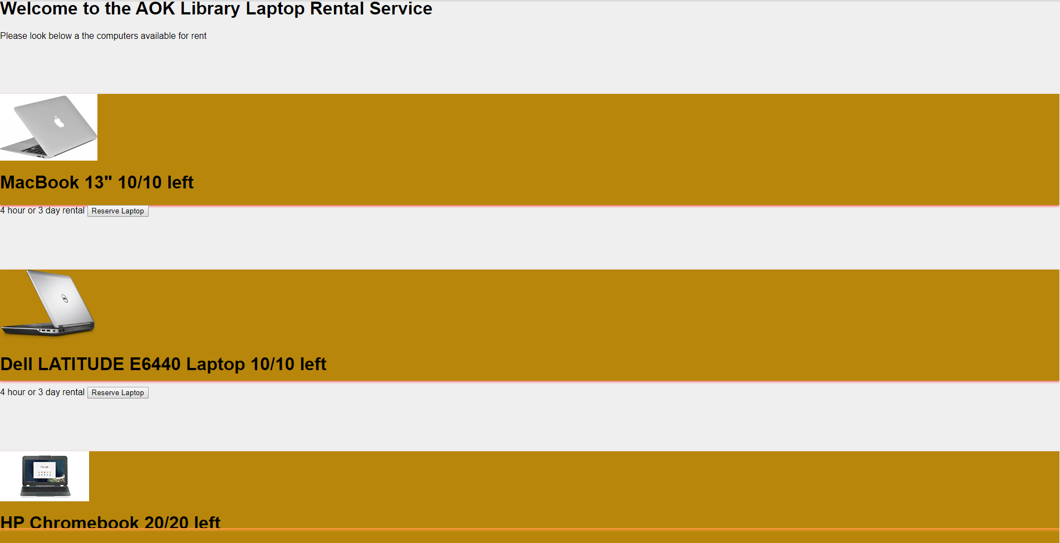
Laptop Rent Page

Slide 9
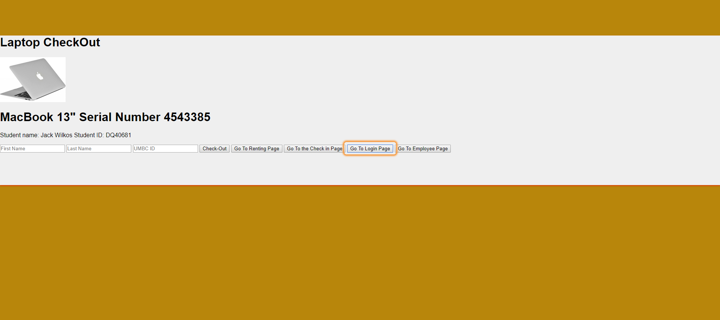
Laptop Check In Page

Slide 10
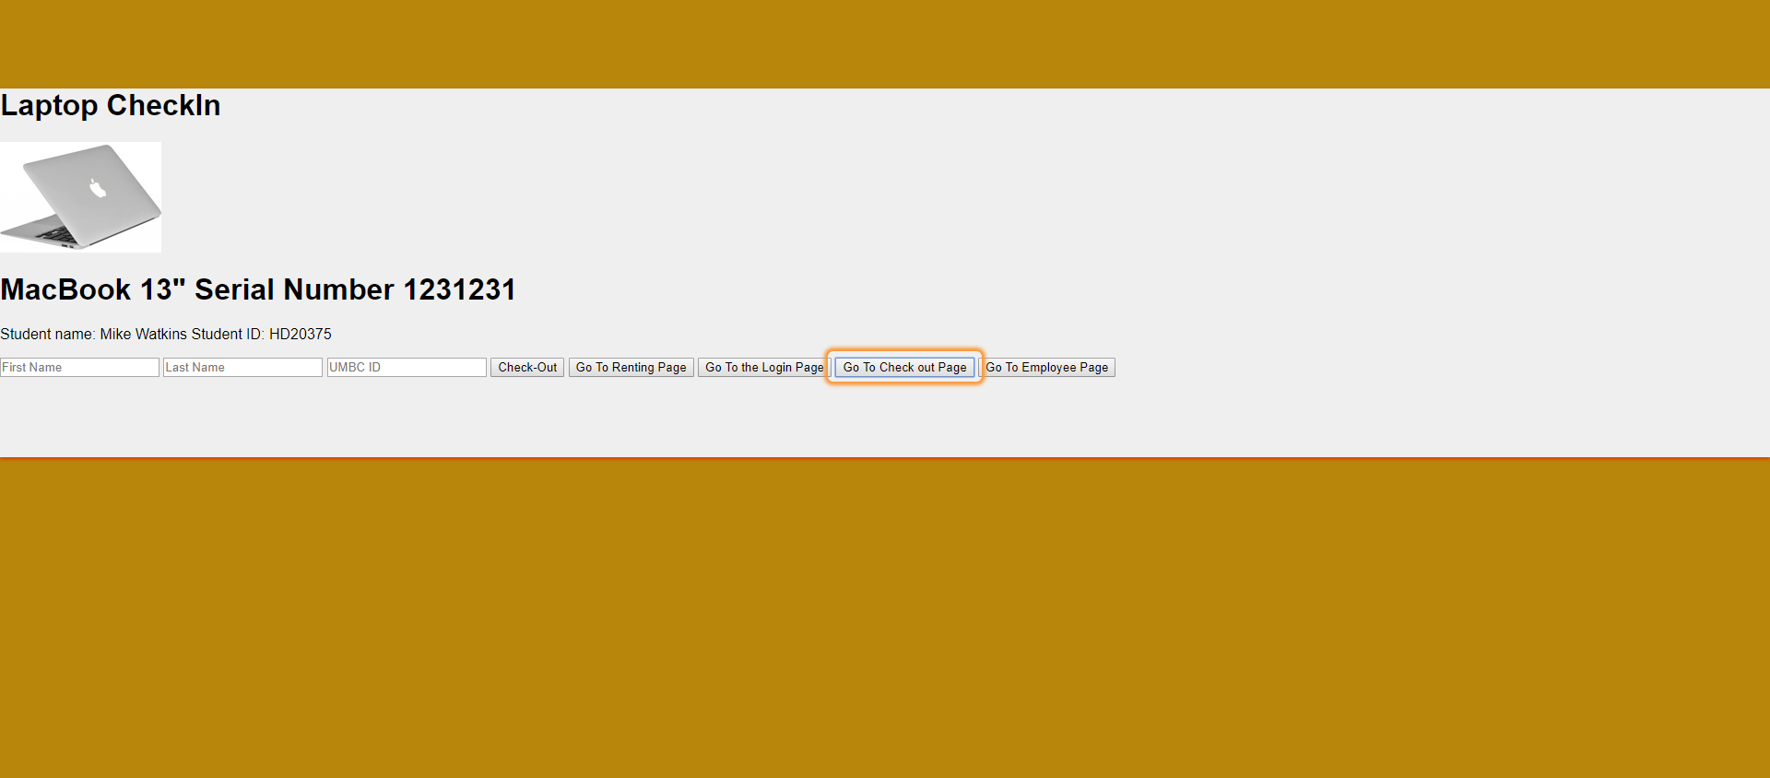
Laptop Checkout Page

Slide 11
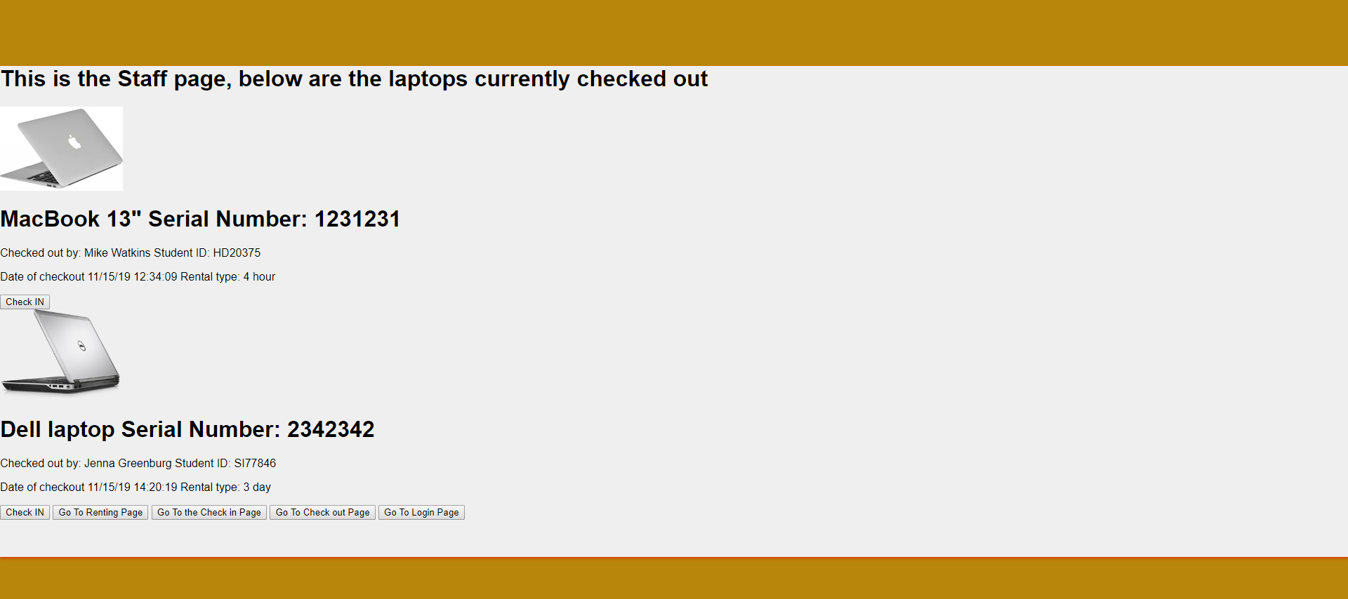
Staff Page

Slide 12
Hardware/Software Requirements
Hardware:
Xeon 28 core processor
6 TB Disk Drive
1 TB of disk space
64 GB RAM
Software:
MYSQL
Windows,Linux,Mac OS
Database:
SQL server 2012
Microsoft SQL
Server:
Dual 1000 Mbps Ethernet

Slide 13
Interface Standard
Interface objects:
Patron/Customer - Requests laptop using the browser
Staff - Accesses the laptop requests made by the patron
Interface Actions/Interface Icons:
Request: Request of Laptop
Login: Login is required to access the service.
Check out : Check out of Laptop
Check in: Check in for loaning laptop
Return: Returning the loaned Laptop.

Slide 14
Interface Standard cntd
Elements on the screen:
Home: Home page of the screen
Student ID: It is required for loaning the laptop.
Login: Login is required to access the service.
Password: Password must be entered for login.
Name: Valid first and last name is required.
Laptop Name: Laptop name has to be entered.
Serial Number: Laptop is identified with the serial number.
Check out : Check out of Laptop
Check in: Check in for loaning laptop
Reservation: Holds reserved laptop

Slide 15
Team Experience/Challenges
Challenging during planning phase because of time conflict.
Lack of coordination from stakeholders (sponsors)
Lack of accurate information/Communication.
Task distribution issues
Lack of agreement on requirements for each phase
Understandings of the improvement.

Slide 16
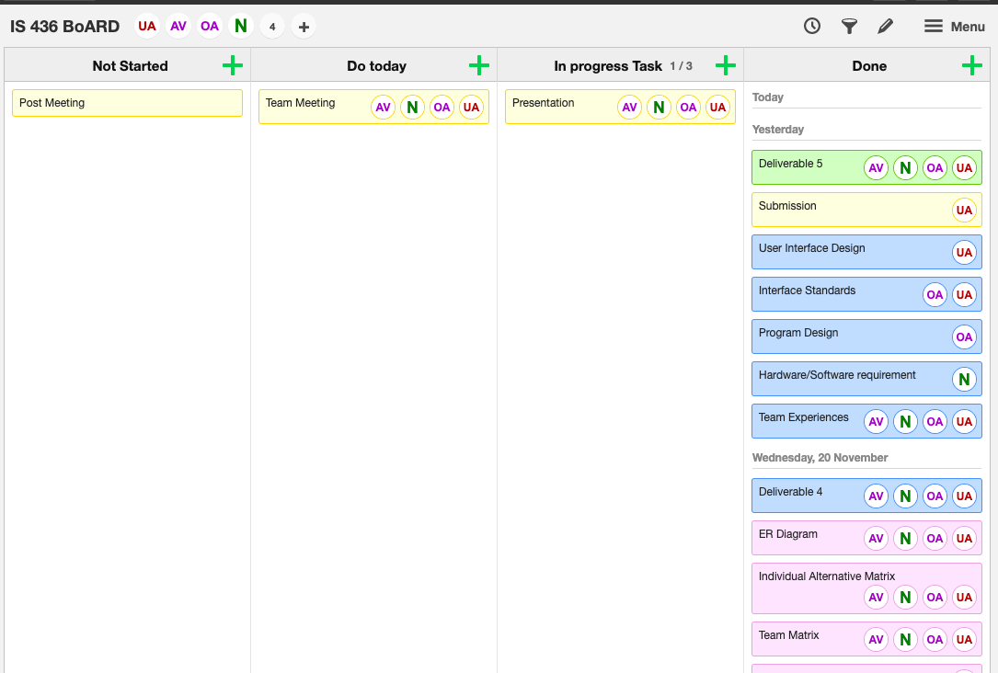
Kanban Board

Slide 17
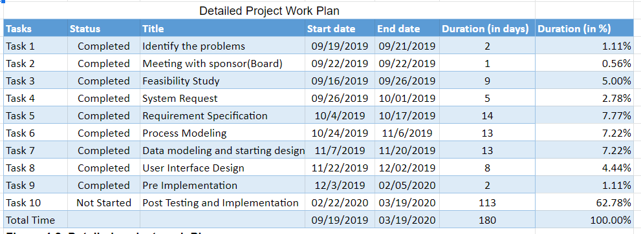
Detailed Project Work Plan

Slide 18
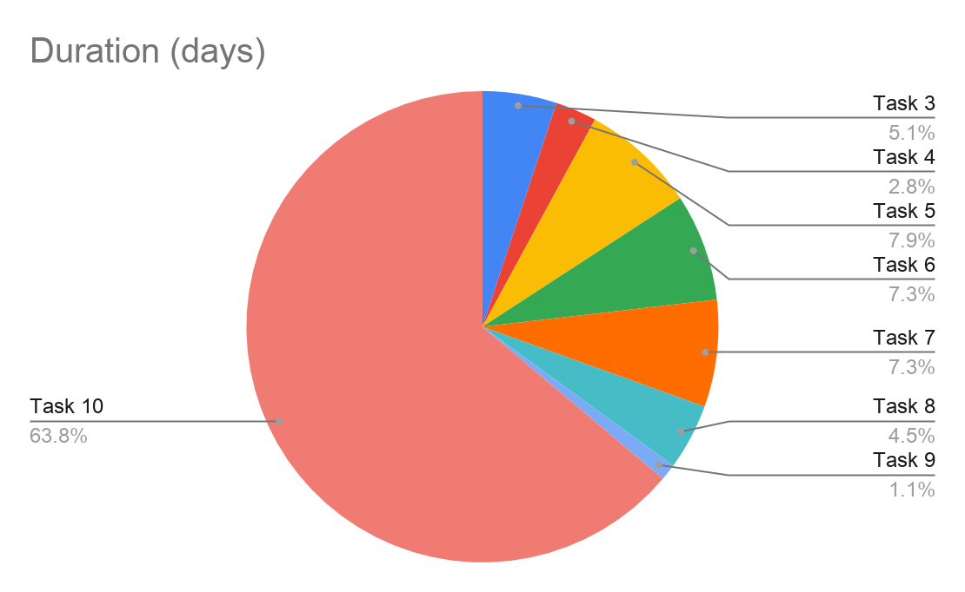
Project Work Plan

